Slide 1

Polygenic scores: Performance and the Importance of Ancestry
John R Shorter
Assistant Professor
Roskilde University

Slide 2
Outline
9:00 AM – 11:00 AM
40 min talk on theory of PGS/PRS. Plus, what to expect with 2 hands-on exercises
11:00 – 11:30
BREAK 1
11:30 PM – 12:30 AM
How PGS perform across ancestries. A hands-on exercise with the PGS catalog.
12:30 PM – 13:30 PM
LUNCH
13:30 PM – 14:30 PM
How do we create PRS? A hands-on lesson with LDPred2

Slide 3
Aims of this lecture
Introduction to polygenic risk scores (PGS/PRS)
Overview of polygenic risk score tools
Ancestry bias in genetic prediction
Learn more about disease prediction using the PRS Catalog
Learn how to create PRS using LDPred2
All information for the workshop is here https://github.com/johnshorter/NSHG-PM2023

Slide 4
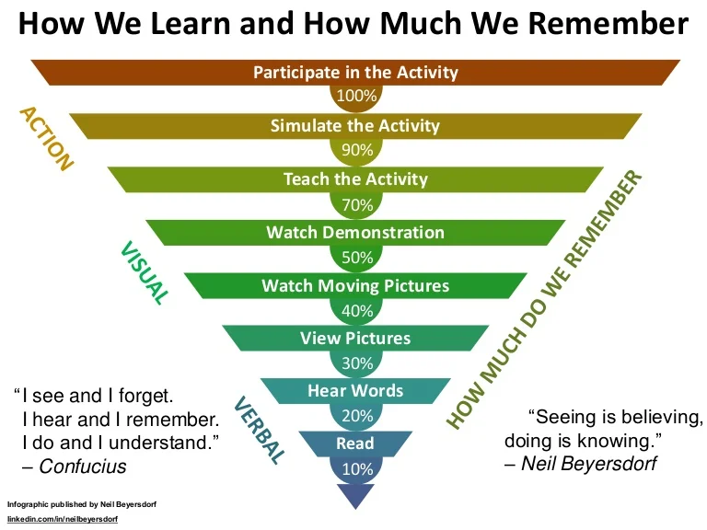
This is an interactive hands-on workshop, so please ask and answer questions ☺

Slide 5
What is a ‘polygenic score’?
By aggregating the effects of many genetic variants into a single number, polygenic scores (PGSs) have emerged as a method to predict an individual’s genetic predisposition to a phenotype
Polygenic risk scores are calculated by summing risk alleles, which are weighted by effect sizes derived from Genome wide association study (GWAS) results
There is widespread variability in PGS research, even regarding nomenclature: the scores can be referred to as genetic or genomic scores, and as polygenic risk scores (PRSs) or genomic risk scores (GRS) if they predict a discrete phenotype (such as a disease)

Slide 6
What’s the use of PGS/PRS?
There is hope that PRS can improve health outcomes by accelerating diagnosis and matching patients to tailored treatments
Access to PRS could be helpful in targeting higher-risk people, for example to offer more screening opportunities such as mammograms, for those at a high genetic risk of breast cancer. (Discussed by Elisabeth Widen yesterday)

Slide 7
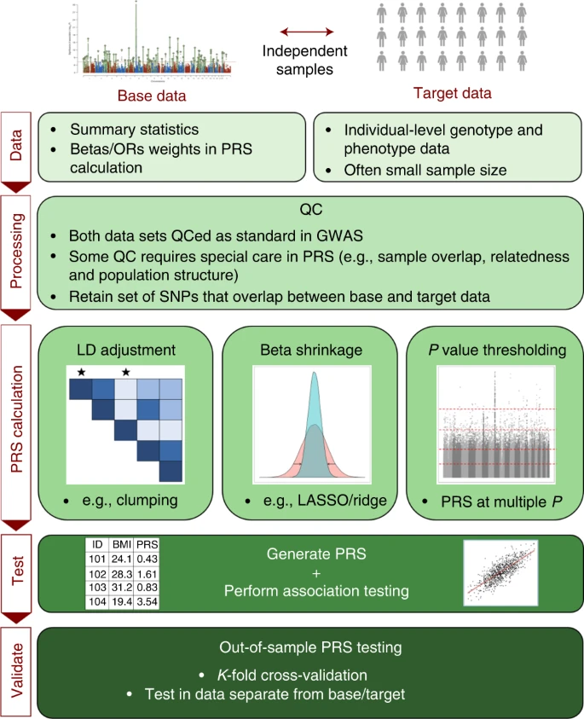
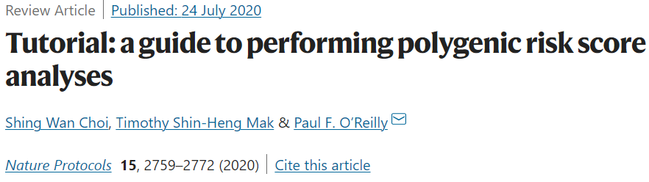
The PRS process, with many details
Issues relating to utilizing PRSs for association analyses to test hypotheses, including interpretation of results and avoidance of overfitting to the target data, are an active area of research
Notes:
Controlling for LD
If genetic association testing is performed using joint models of multiple SNPs47, then independent genetic effects can be estimated despite the presence of LD. However, association tests in GWASs are typically performed one SNP at a time, which, combined with the strong correlation structure across the genome, makes estimating the independent genetic effects (or best proxies of these if not genotyped/imputed) extremely challenging. If independent effects were estimated in the GWAS or by subsequent fine-mapping, then PRS calculation can be a simple summation of those effects. If, instead, the investigator is using a GWAS based on one-SNP-at-a-time testing, then there are two main options for approximating the PRS that would be obtained from independent effect estimates: (i) SNPs are clumped (i.e., thinned, prioritizing SNPs at the locus with the smallest GWAS P value) so that the retained SNPs are largely independent of each other, and, thus, their effects can be summed, assuming additivity; and (ii) all SNPs are included, accounting for the LD between them. In the classic PRS calculation method5,11,13, option (i) is combined with P value thresholding and called the C+T (clumping + thresholding) method, while option (ii) is generally favored in methods that implement traditional shrinkage techniques

Slide 8
Many different PRS tools! And more will come
PLINK (Purcell et al., 2007) is a widely used open-source tool for genome-wide association studies (GWAS) and PRS analysis. It provides a comprehensive set of commands for data quality control, association analysis, and PRS calculation.
PRSice (Euesden et al., 2013) is an R package that offers a user-friendly interface for PRS analysis. It allows for flexible PRS construction and provides options for various statistical methods and p-value thresholds.
LDpred (Vilhjálmsson et al., 2015) is a tool specifically designed for PRS calculation using summary statistics from large-scale GWAS data. It incorporates linkage disequilibrium (LD) information to improve the accuracy of risk score estimation.
SBayesR (Wen et al., 2016) is a Bayesian method for PRS analysis that uses summary statistics from GWAS to estimate the effect sizes of genetic variants. It has been shown to perform well, particularly when the heritability of the trait is low.
PRS-CS (Ge et al., 2019) is a tool that incorporates LD information and functional annotations to estimate the effect sizes of genetic variants and calculate PRS. It aims to improve the accuracy of PRS by leveraging additional information beyond summary statistics.
LDpred2: (Prive et al., 2020) better, faster, stronger version
LDpred3: The LD strikes back; SBayesR4: A New Hope; PRSice5: The Return of the User-friendly Interface

Slide 9
I don’t care, just tell me which one is the best!

Slide 10
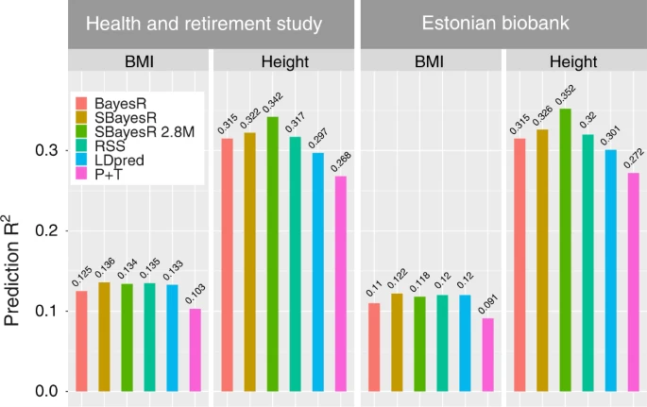
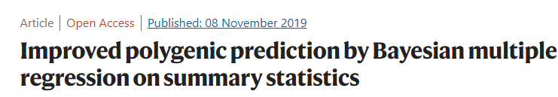
How do they perform? What one is the ‘best’?

Slide 11
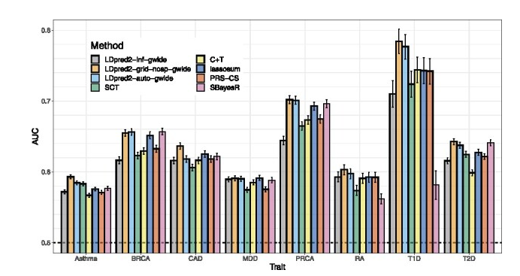
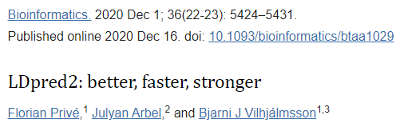
How do they perform? What one is the ‘best’?

Slide 12
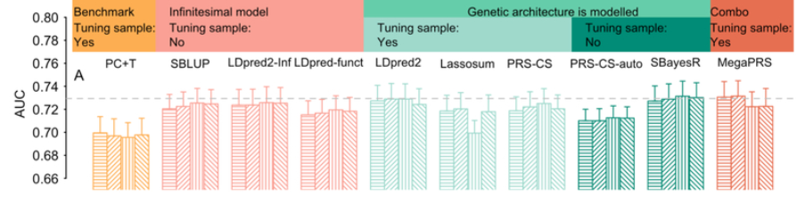
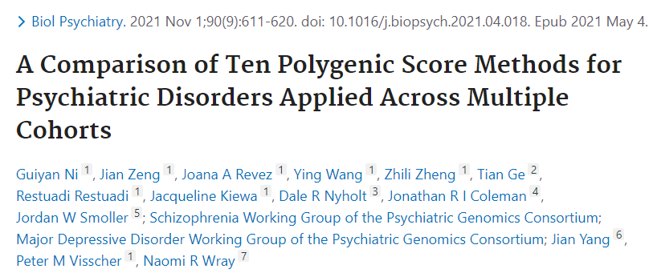
How do they perform? What one is the ‘best’?
Although the methods that more formally model genetic architecture have similar performance, MegaPRS, LDpred2, and SBayesR rank highest in most comparisons and are recommended in applications to psychiatric disorders.

Slide 13

So, I can’t tell you what is best, and better tools will be developed in a few years!

Slide 14
How much variation does PRS explain again?
We first need to discuss heritability

Slide 15
The many types of heritability
Broad-sense heritability (H²) is a measure that estimates the proportion of phenotypic variation in a population that is due to all genetic factors, including both additive and non-additive genetic effects. It includes the effects of additive genetic variation, dominance genetic variation and interactions between different loci.
Narrow-sense heritability (h²) is a measure that specifically estimates the proportion of phenotypic variation in a population that is due to the additive genetic effects of individual alleles or genetic variants.
SNP heritability (h²_{SNP}) is a measure that specifically quantifies the proportion of phenotypic variation that can be explained by the additive effects of single nucleotide polymorphisms (SNPs), which are common genetic variants in a population. SNP heritability is estimated using genome-wide association study (GWAS) data

Slide 16
So, does PRS = h²_{SNP}?
NO!
Tell me what are some things it could be missing? (It does depend on the tool)
Some tools only use SNPs at a p-value cutoff
Most markers are lost, if you are joining with HapMap3
The X chromosome is often not included
Rare variation with strong effects Markers with low imputation INFO score
Gene by environment interactions
Others…?

Slide 17
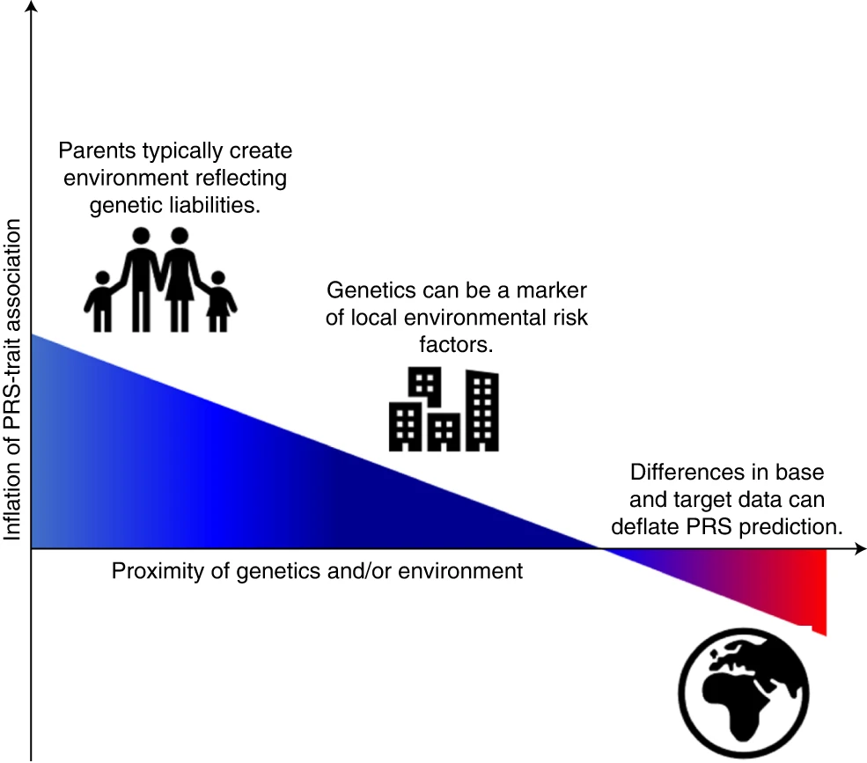
Major sources of inflation/deflation of PRS-trait associations
This inflation can be exacerbated by a household effect in which parents produce an environment reflecting their genetic tendencies, known as passive gene*environment correlation.
Correlation between the population structure of genetics and the environment can inflate PRS-trait associations unless they are controlled for fully.
If the target data differ markedly from the base data, then the PRS-trait association will probably be deflated relative to a target sample that is well matched to the base data.

Slide 18
PRS is not deterministic!
It only captures a fraction of the total genetic variation
Lots of important genetic information is not yet captured my most PRS tools
Other environmental factors can play a bigger role is disease risk

Slide 19
Now let’s discuss ancestries and PRS

Slide 20
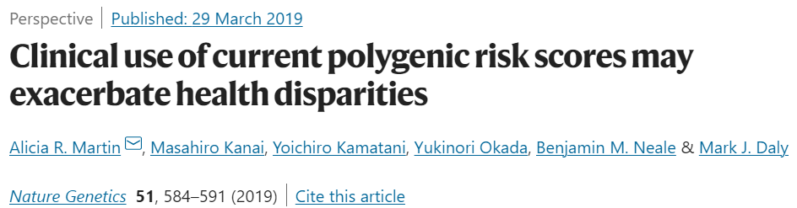
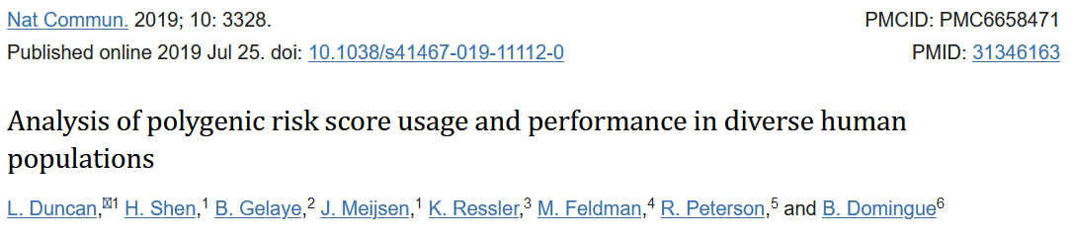
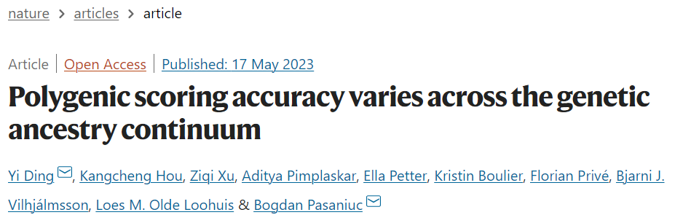

Slide 21
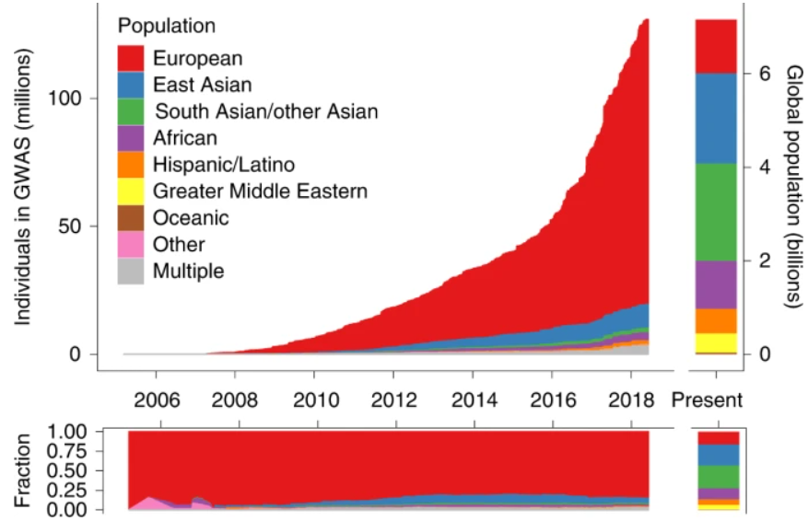

Ancestry of GWAS participants over time shows a bias

Slide 22
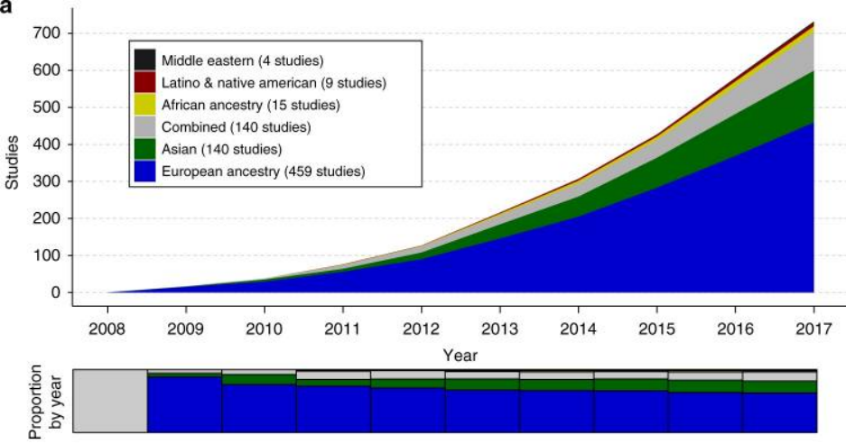
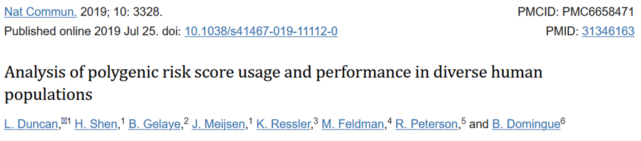
Ancestry representation in the first decade of polygenic scoring studies shows a bias

Slide 23
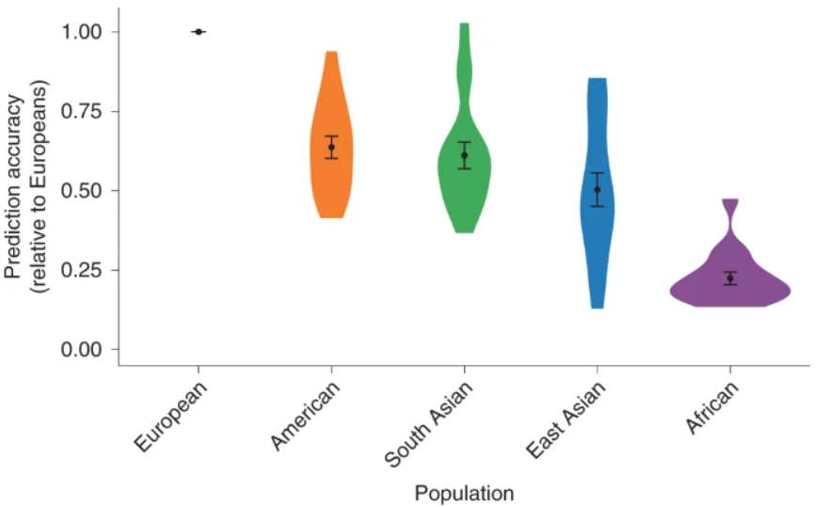
Prediction accuracy relative to European-ancestry individuals across 17 quantitative traits and 5 continental populations in the UKBB

Slide 24
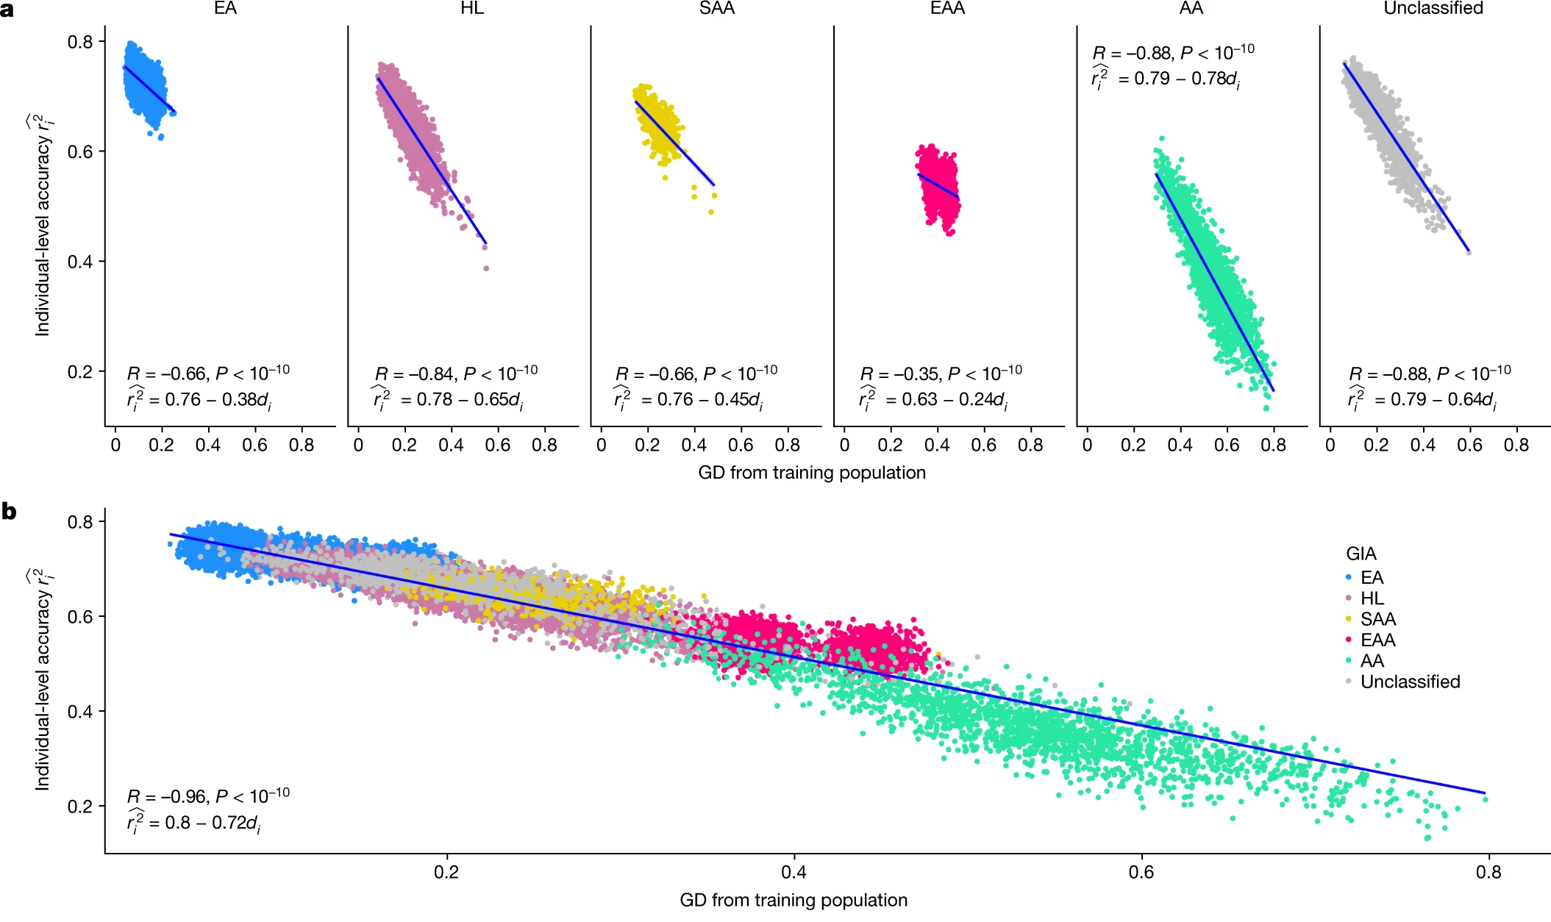
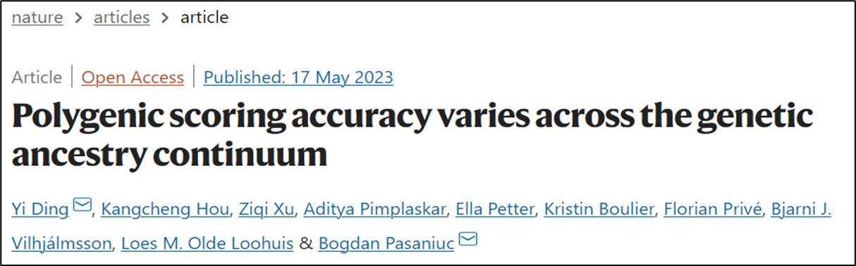
The individual-level accuracy for height PGS decreases across the genetic ancestry continuum in ATLAS
EA, European American;
HL, Hispanic Latino American;
SAA, South Asian American;
EAA, East Asian American;
AA, African American.

Slide 25

We will explore this together using your favorite disease/trait!

Slide 26
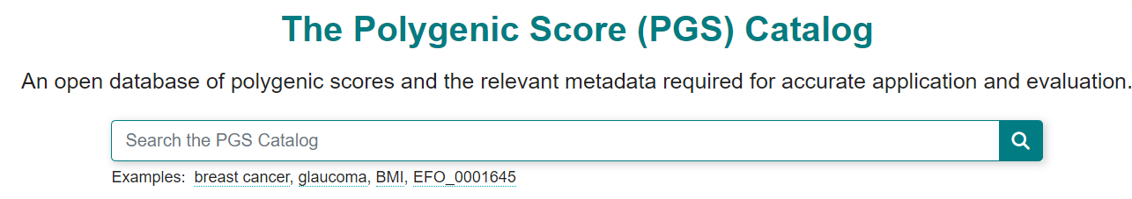
The Polygenic Score Catalog as an open database for reproducibility and systematic evaluation
https://www.pgscatalog.org

Slide 27
Background on this catalog
The challenges
There are major challenges with using PRS/PGS due to the lack of consensus on what is reported by researchers and how it is expressed.
The underreporting of key PGS information has led to problems comparing different scores that predict the same diseases, and testing which are the most accurate.

Slide 28
Background on this catalog
The solution
The PGS catalog is an open resource of published PGSs, that includes full scoring information annotated with the expertly curated metadata. It allows PGSs to be reused and evaluated so their accuracy and clinical value can be fully assessed.

Slide 29
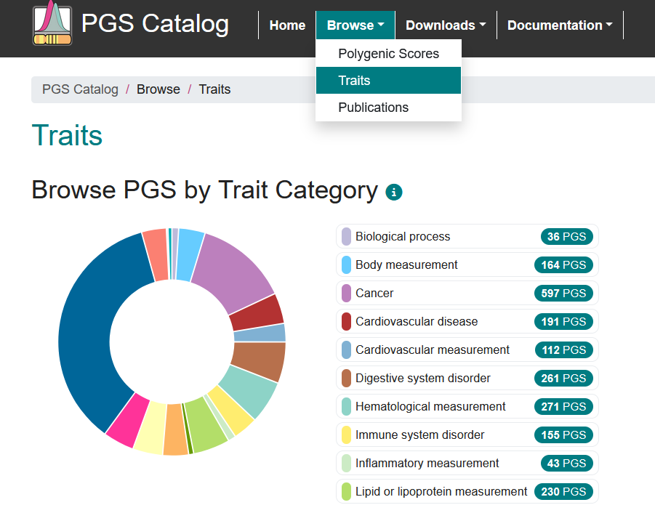
Let’s select a trait

Slide 30
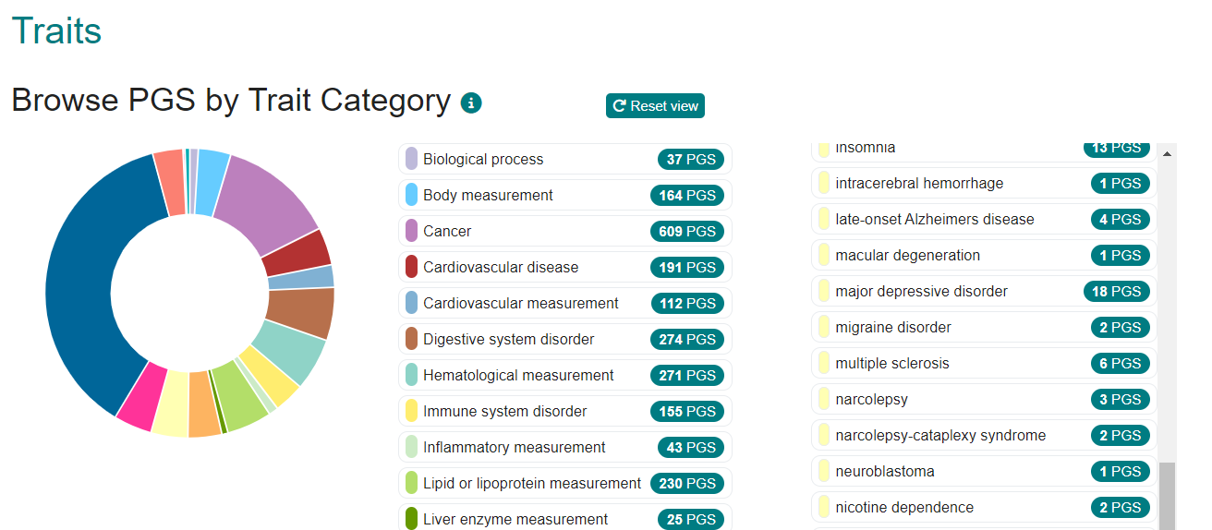
Several options to choose from

Slide 31
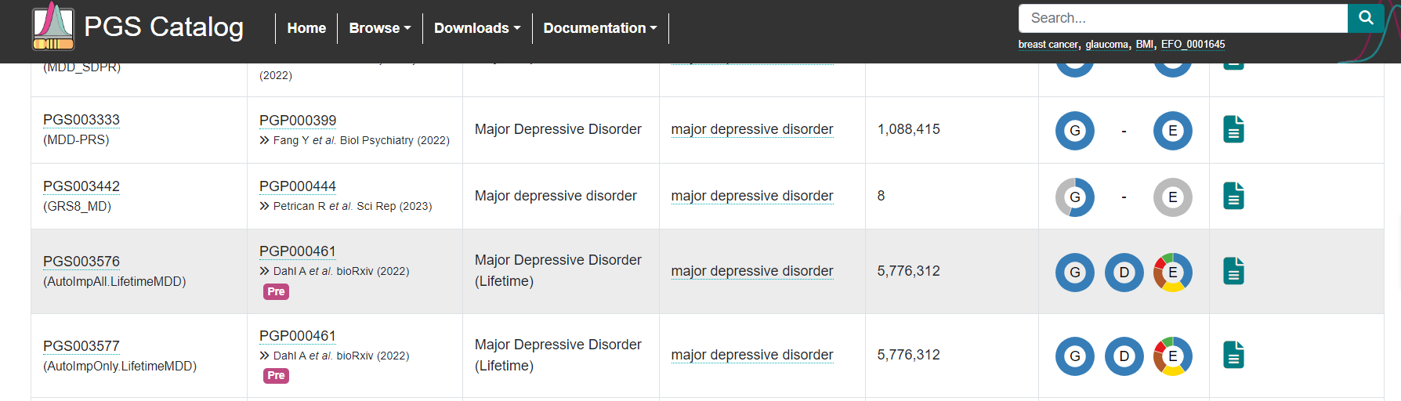
Let's pick this study

Slide 32
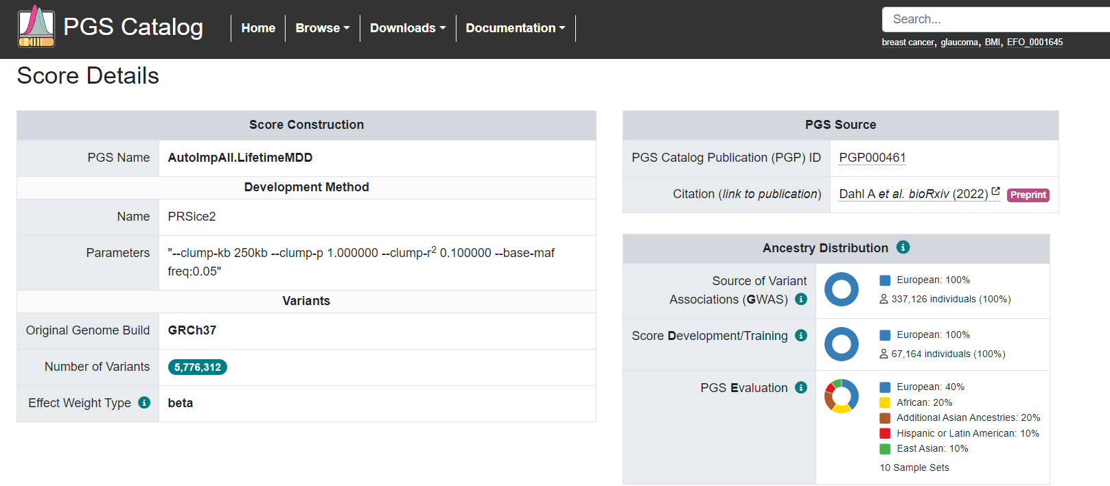
On this page you will find the number of significant variants, population ancestry, etc.

Slide 33
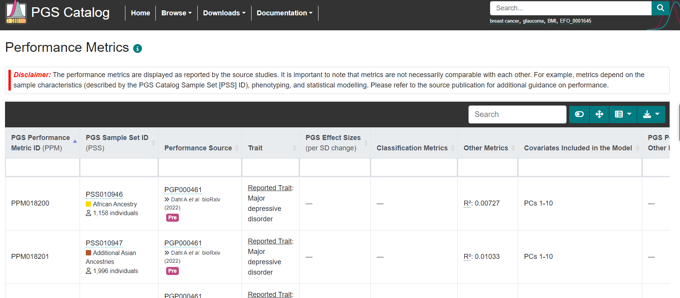
What are the performance metrics?

Slide 34

Now, tell me, why would some traits have OR/HR and others do not?

Slide 35
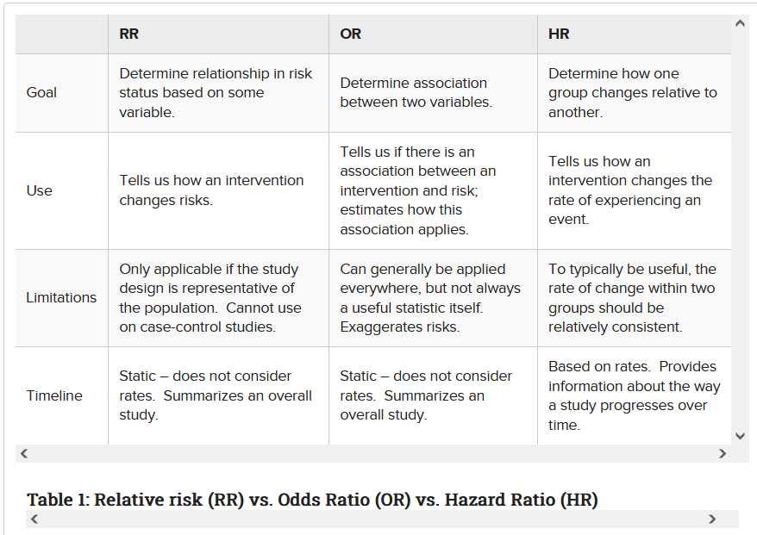
A little side note about Odds Ratio and Hazard Ratio

Slide 36
A little side note about other metrics
R-squared is a measure of the proportion of variance explained by the PRS in the phenotype of interest.
It quantifies how well the PRS predicts the phenotype and indicates the proportion of the phenotype's variability that can be attributed to genetic factors captured by the PRS. Higher R-squared values indicate a stronger relationship between PRS and phenotype.
Area Under the Receiver Operating Characteristic Curve (AUROC) is a metric commonly used in binary classification problems to evaluate the discriminative ability of a PRS model.
It represents the probability that a randomly selected case will have a higher PRS than a randomly selected control. AUROC ranges from 0.5 (no discrimination) to 1.0 (perfect discrimination). Higher AUROC values indicate better discriminative performance of the PRS model.

Slide 37
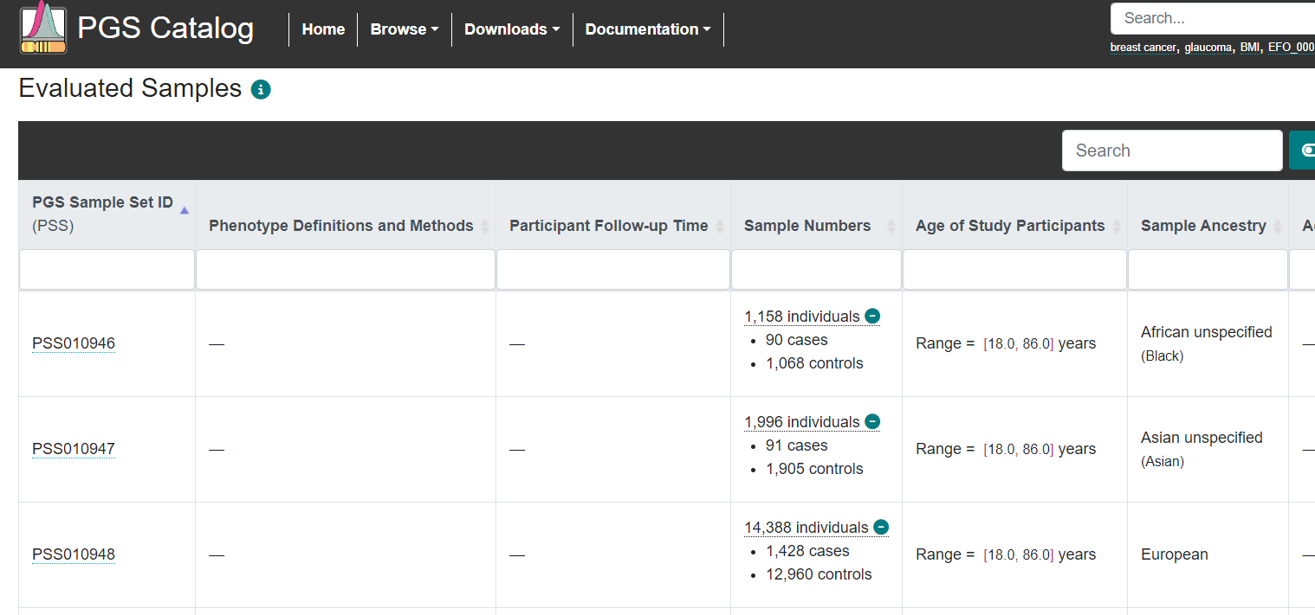
And information on the test samples

Slide 38
Your exercise today is to report how well PRS/PGS predicts your favorite disease/trait
As a group, we will fill out a google document about the performance of PGS/PRS on your favorite disease or trait (Maybe some should download and fill out the sheet locally, and add to the group sheet when finished)
Report the study name and ID, the sample size, number of variants, and ancestry distributions
What is the performance metrics? Are they done in the same or different ancestry populations? What are the reported PGS effect sizes or other metrics?
We will then discuss our finding together, and see how PRS performs across different ancestries

Slide 39
Using LDpred2 to create PRS

Slide 40
What to expect
I only have 1 hour to teach you how to use this tool!
We will therefore use this wonderful tutorial on LDpred2
https://privefl.github.io/bigsnpr/articles/LDpred2.html
This is written by Florian Privé
I have created an R markdown version of this, and we can go through each section and discuss key elements
You will need R and R studio to participate. (Or just watch and follow along)
You can always go back to this and watch his video tutorial

Slide 41
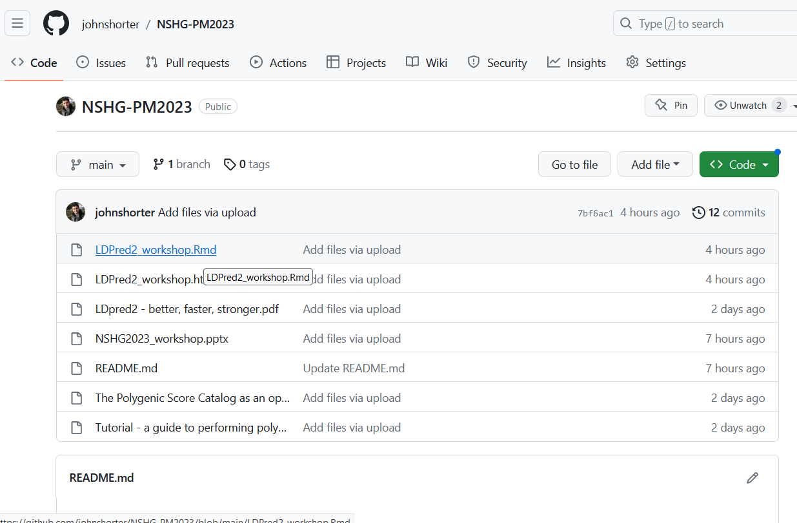
Following the GitHub link takes you here

Slide 42
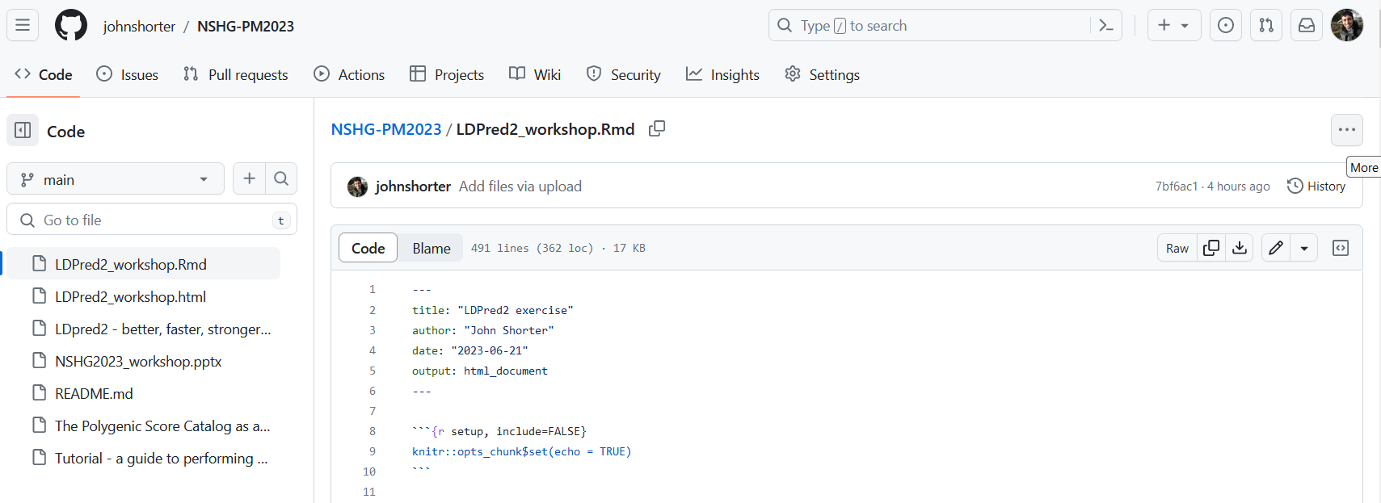
Click the three dots, and select download

Slide 43
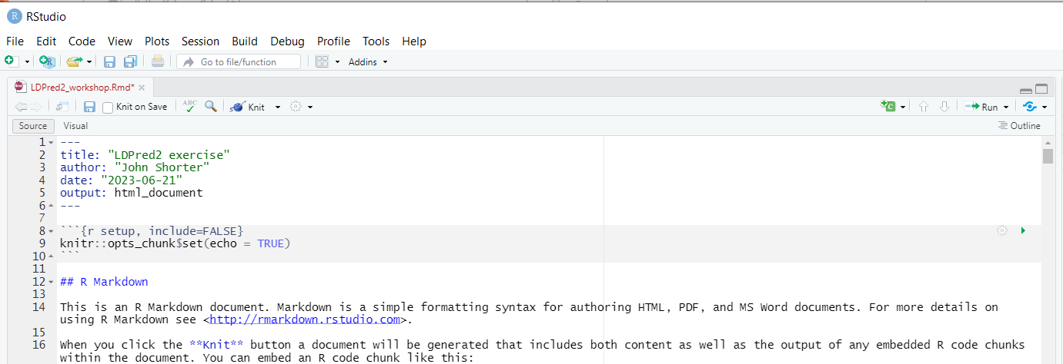
Then open the Rmd file and it should open in RStudio

Slide 44
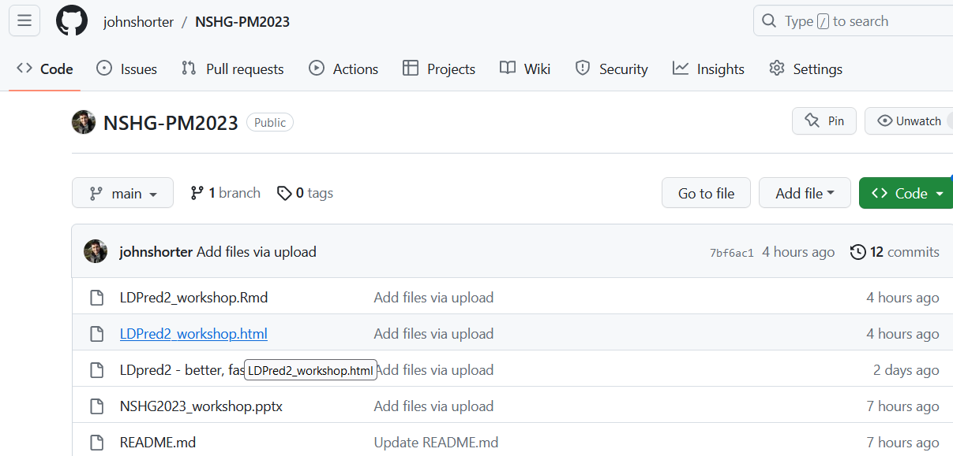
If this does not work, use the html version

Slide 45
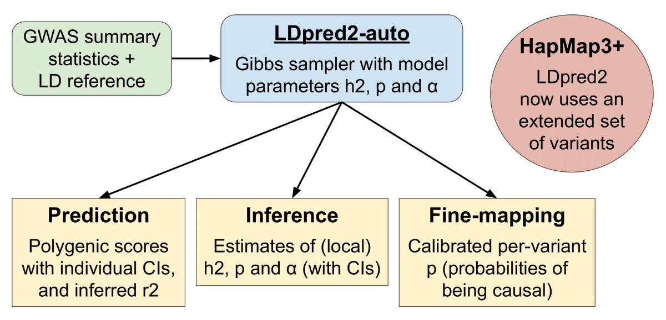
What can LDpred2 do?

Slide 46
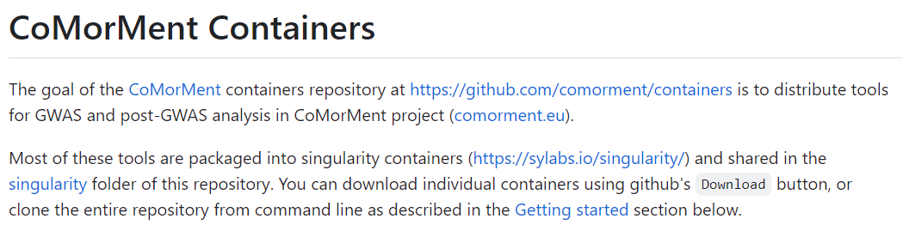
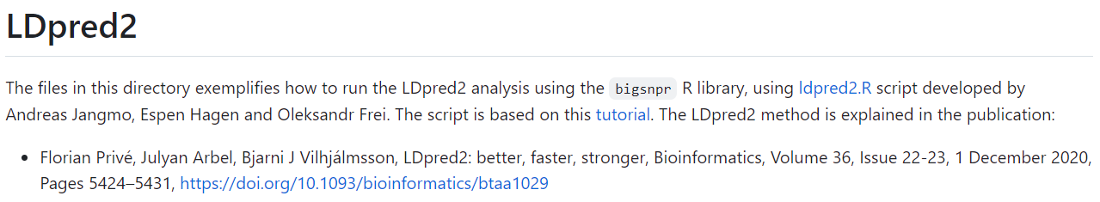
An important detail about using R for PRS
For a full data set, the memory usage is very heavy on your laptop
I am using the CoMorMent containers for analysis, and run it on my HPC
It is very easy to run different PRS tools on the containers!

Slide 47
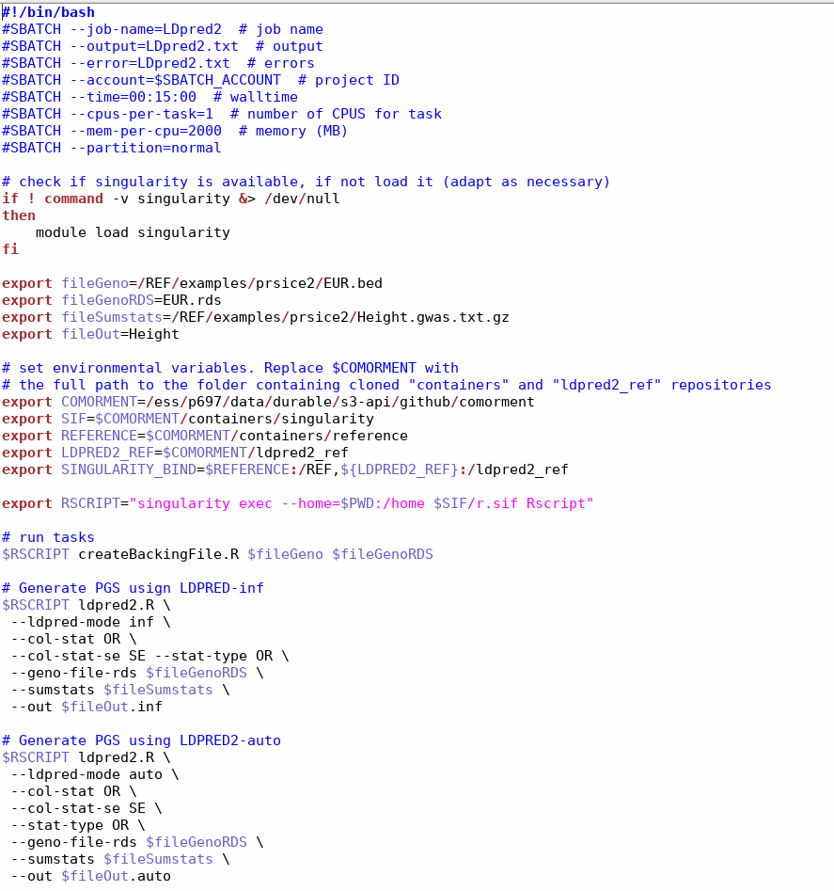
Here is the script for the tutorial data for PRSice on the containers

Slide 48
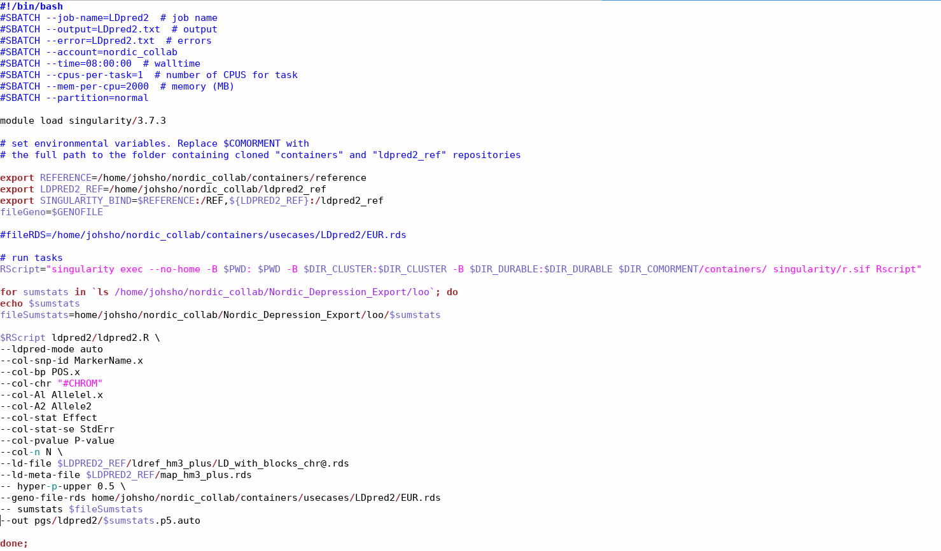
Here is the script for the tutorial data for PRSice on the containers

Slide 49
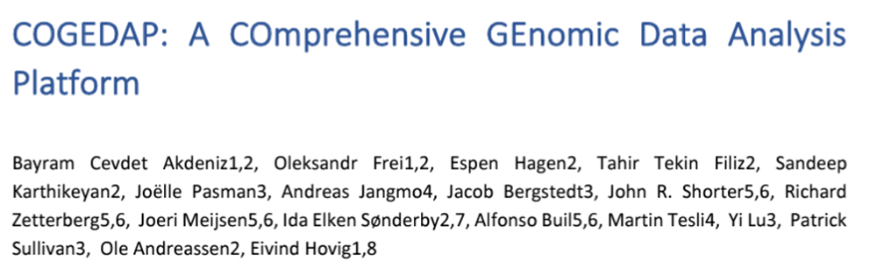

Slide 50
What you will need to do for this PRS workshop
Find my GitHub: https://github.com/johnshorter/NSHG-PM2023
Download R and RStudio (Maybe older versions work?)
If you are interested in the LDpred2 exercise, download the required packages

Slide 51

Any questions?
I have PRS questions for you. ☺ 1) I want to create a PRS for each individual in my test set. There is moderate overlap between GWAS samples and PRS samples. Is that okay? 2) True or False: the predictive power of PRSs are typically substantially lower than h²_{SNP}

Slide 52
Bonus slides

Slide 53
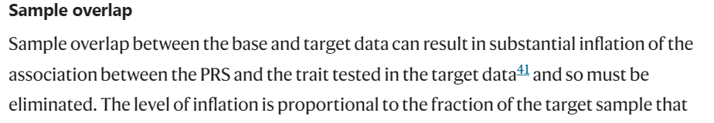
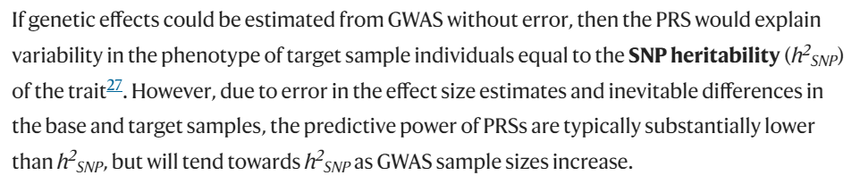

Slide 54
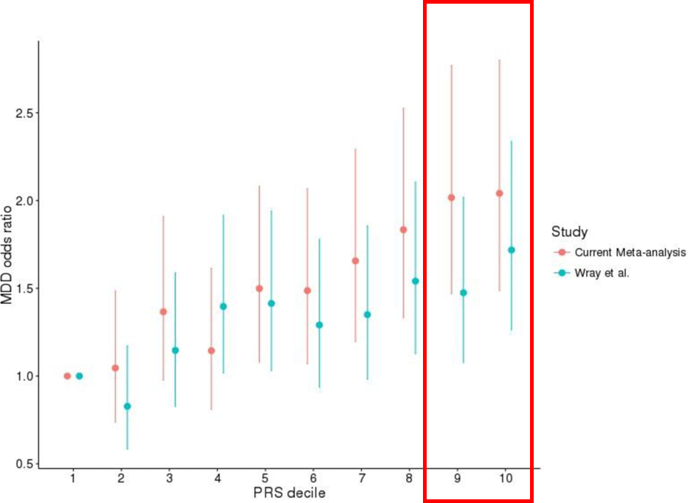
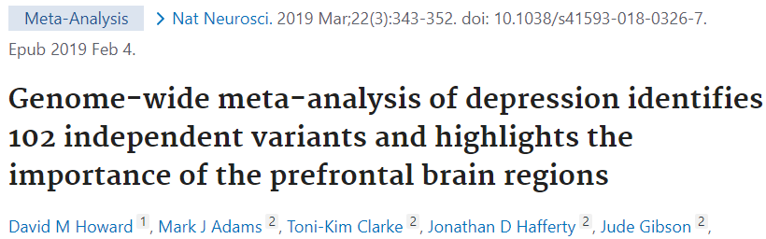
The clinical use of PRS is better at identifying those with the highest disease
But there are other challenges

Slide 55
Genetic models of disease
Mendelian disease:
Individuals that possess the mutation get the disease.
Dominant e.g Huntington’s or recessive e.g. Cystic fibrosis
Mendelian disease with variable penetrance.
Not everyone with the mutation gets the disease.
E.g. C9orf72 in Amyotrophic lateral sclerosis (ALS)
Oligogenic diseases –caused by presence of several genetic risk variants
Polygenic diseases – caused by multiple genetic risk variants

Slide 56

Danish PRS guidelines
https://dsmg.dk/kliniske-guidelines/dsmg-guidelines/

